Slide 1
Welcome to Everybody

Slide 2
পরিচিতি
দিলীপ কুমার পাল
টেকনিক্যাল টিচার্স ট্রেনিং কলেজ
ইইই বিভাগ

Slide 3
পরিচিতি
ডিপ্লোমা ইন টেকনিক্যাল এডুকেশান
ইইই বিভাগ
১ ম সেমিস্টার

Slide 4
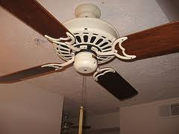
Electric Fan

Slide 5
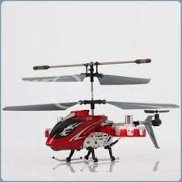
Helicopter

Slide 6
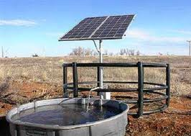
Solar Operated Pump

Slide 7
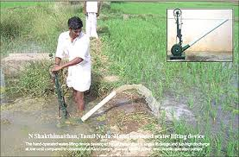
Irrigation

Slide 8
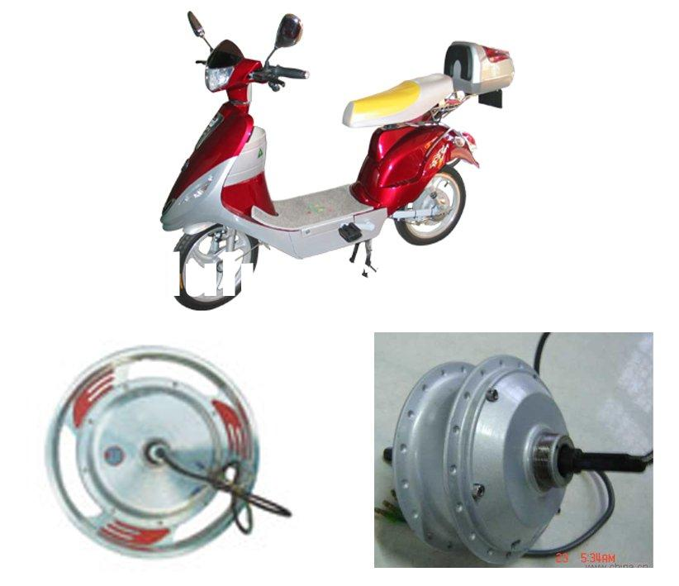
D C Motor

Slide 9
শিখন ফল (Learning Outcomes)
Will be able to explain the principle of motor action
Will be able to explain the interaction of two lines of forces

Slide 10
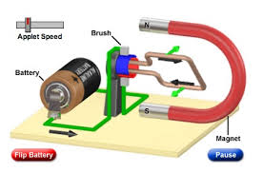
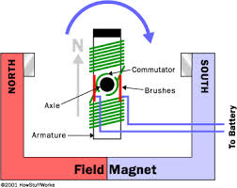
Magnet as Stator & Battery driven Rotor conductor
Magnet as Stator & Rotor with winding

Slide 11
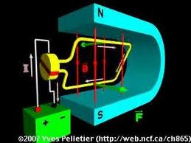
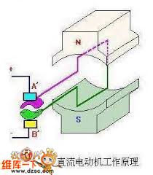
Horseshoe Magnet & Rotor Coil
Permanent Magnet(Stator) & Rotor conductor

Slide 12
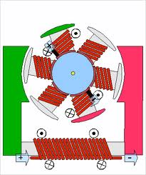
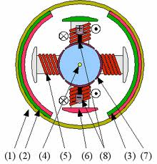
Field Winding & Rotor winding
Magnet(Stator) & Rotor winding

Slide 13
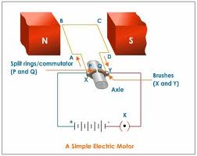
An electric motor is a machine which converts electrical energy into mechanical energy

Slide 14
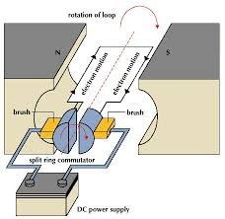
When a current carrying conductor is placed in a magnetic field, it experiences a mechanical force.

Slide 15
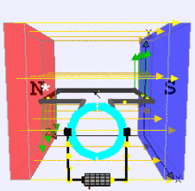
Motor action due to both magnetic & Current carrying Conductor

Slide 16
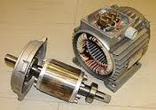
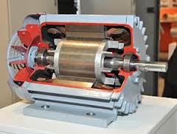
Stator & Rotor
Internal View of a motor

Slide 17
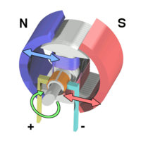
মুল্যায়ন(Evaluation)
Explain the principle of D C Motor action by analyzing two magnetic lines of forces.

Slide 18
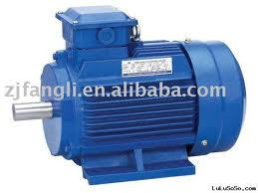
Thanking You

